Slide 1





Slide 2
 | Deliverable Checklist / Plan
Minutes (8 total) | Delivered on Slide | # | Deliverable/Aspect
 | This column is blank for now, to be filled in when we’re done |  | System Architecture
1 |  | SA1 | A representation of the system architecture, including the architectural decisions that the team made and why, and potentially functional or form decomposition if relevant.
 |  | SA2 | An analysis of value delivery and prioritization of stakeholders and / or goals.
1 |  | SA3 | A system problem statement and an explicit system boundary.
0.5 |  | SA4 | A description of the broader context in which the system sits, a matched rationale for the rate of architectural change to expect.
 |  | SA5 | An articulation of the competitive strategy to be used in the market with the chosen architecture.
 |  |  | System Engineering
0.5 |  | SE1 | System requirements include traceability from system value and stakeholder needs to subsystem and component requirements.
0.5 |  | SE3 | Different concepts you generated and how you down selected to the preferred system concept.
0.5 |  | SE4 | Verification and Validation strategy.
 |  | SE5 | Operations and lifecycle considerations.
0.5 |  | SE2 | Systems Engineering methods and tools used – why did you choose them and what methods you considered not to be appropriate for your project. (This is SE2, out of order, because I reordered the deliverables to discuss this with SE6. –David)
 |  | SE6 | Reflection on team learning about systems thinking.
 |  |  | Project Management
1 |  | PM1 | Targets (driven by value) and estimates (driven by feasibility) are compared related to scope, cost, and duration.
 |  | PM2 | The expected scope is clearly described, structured at a level of sustainable granularity, related to the system and its value, and measurable.
1 |  | PM3 | Organization approach is selected. Critical resources and skills are called out.
 |  | PM4 | Choices for structuring and integrating the product system, workflow process, and project organization are highlighted, particularly those choices which are exceptions to standards or conventional wisdom.
1 |  | PM5 | The results of design, prototyping, and validation tasks by the project team to date are reflected in an estimate of future implementation activities.
 |  | PM6 | Risks and mitigations are assessed and integrated into the project plan. Uncertain work, re-work, and coordination activities are considered.
 |  | PM7 | Amongst a set of project scenarios, the team proposes a preferred and backup scenarios for system implementation. Concerns from stakeholders are anticipated and addressed.
Notes:
Motivation, Problem, Solution, Impact
Motivation: SA4, SA5, SA3 about motivation/problem/scope, and also PM2 and
Solution: SA1, SE1, SE3
Stakeholders? SA1
SA = problem, big picture
Transition = what is the solution
Consider funnel process of start with big problem, sharpen it until we downscope to something we can solve
SE = How to technically deliver
PM = how to land impact on schedule/budget

Slide 3
Presentation Evaluation
System Architecture (20%)
• Did the team apply relevant analysis and logic to reach conclusions about architecture?
System Engineering (20%)
• Did the team apply relevant methods from SE to produce a credible recommended system solution?
Project Management (20%)
• Did the team design feasible, valuable, and risk mitigation plan(s) for subsequent stages of the project?
Argument and Communication (20%)
Does the recommendation follow from evidence-based motivation and problem framing followed by clear arguments? Does the recommendation deliver value to the most important stakeholders? Is the document effective, persuasive and appropriate for a non SDM executive decision maker?
Unique Insights (20%)
Does the analysis produce non-obvious, interesting results?

Slide 4
Outline
[1.5-2min] Problem (read by David)
[Done] Hook
[Done] Mayo clinic model of care
[Done] some visual way to emphasize risk intolerance AND OR physician facing=competitive advantage
It might be nice to discuss risk here, but i’m not sure if it’s necessary because the iron triangle slide in the next section hits it
[Done] SPS
[2min] Concept (read by David)
[Done] [30sec] Iron triangle priorities, charter targets, emphasis on risk intolerance
[Done] [30sec] stakeholders and how they inform the concept of operations
[Done] both the old and new sequence diagrams
[2min] Solution (read by Camden)
[MVP] [30sec] monte carlo
[Maybe?] [30sec] Our strategy is not a platform and why
It’s a nice-to-have but time is really tight
[Done] [1min] DSM (read by Norah)
[2min] Delivery (read by Camden)
[MVP] design walk tradespace, de-risking
[Maybe?] David might draft one more slide for you about organization and resources
PM wants us to show thinking about that, but time is tight
[Done] Final solution we prefer
[Maybe?] Visual for talking point about how the maximalist end point reduces rework risk by bolstering v&v

Slide 5
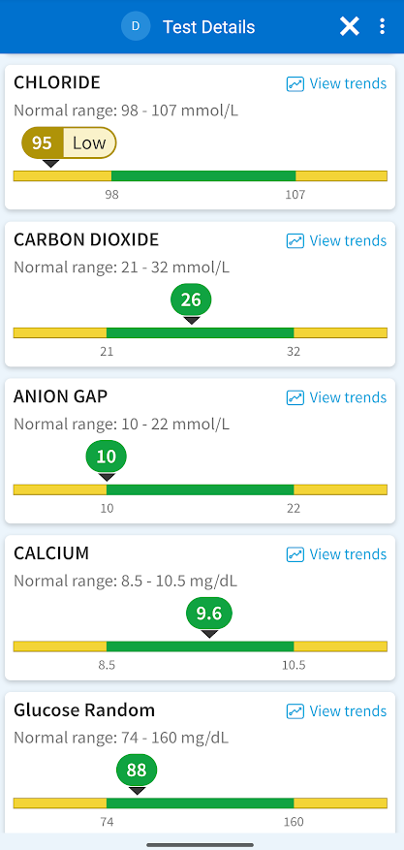


?
?
?
Notes:
How many of you have ever gotten a blood test? This is an actual screenshot of a blood test I got. I have no idea what it means to have low chloride. Does that sound like a familiar experience? Fortunately, this is a common blood test, so my doctor was able to interpret it for me. I’m fine. But this happens at the medical level too…

Slide 6

Problem
Concept
Solution
Delivery

Slide 7



Slide 8
?
?
?

Slide 9

Avoid Competitors
Mitigate Hallucinations
Customer Focus
Notes:
Explain the need of a clinical librarian to navigate between an ocean of data and information, in order to get the precise interpretation to the patient.

Slide 10



To improve Mayo Clinic lab patient care outcomes at scale
By augmenting physician-facing test results with relevant research
Using an agentic AI clinical librarian
Notes:
Here we need to link the "clinical librarian" with the the previous slide which mention the large data Mayo Clinic has.

Slide 11
Problem
Concept
Solution
Delivery

Slide 12
Stakeholder needs
Top Stakeholders, Top Needs
External Patient
External Physician
External Laboratory
Mayo Clinic Labs
Care
Interpretation
Test Results

Slide 13
Lab Workflow Current
Lab interpretation workflow - Current
External Patient
External Physician
External Laboratory
Mayo Clinic Labs
Patient Record
Medical consultation
Exam request
Exam schedule
Collects and send samples
Analyses and store results
Raw test results
Notification of results
Result explanation
Notification of results

Slide 14
Lab Workflow
Lab interpretation workflow - Proposed
External Patient
External Physician
External Laboratory
Mayo Clinic Labs
Patient Record
Mayo Clinic Knowledge
Sanguine
Medical consultation
Exam request
Exam schedule
Collects and send samples
Analyses and store results
Test raw results
Request patient context
Send patient clinical context
System Boundary
Request clinical references
Send clinical references
Notification
Notification of results interpretation complete
Notification
Deliver personalized interpretation
Access test interpretation and provide feedback

Slide 15
Iron Triangle
3 test types
1 hour latency
96% accuracy!
Scope
12 months
…
…
$6M setup
$20 / test
…
Schedule
Cost

Slide 16
Problem
Concept
Solution
Delivery

Slide 17
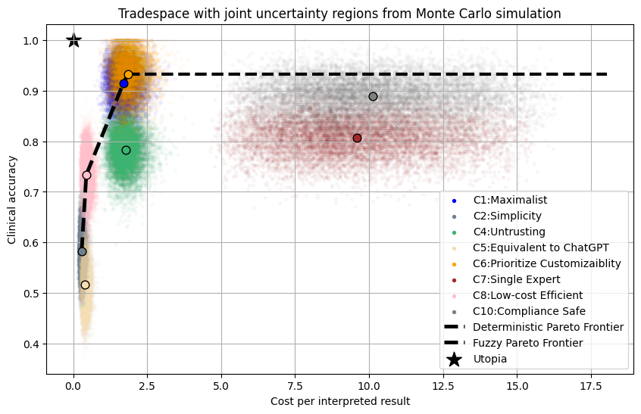
Review Model:
Partial Review
Review Model: Fully Autonomous
Group Size: Increasing
Decisions:
Agent group size
Review model
…

Slide 18
ID | Decision name | Rationale | Option 1 | Option 2 | Option 3 | Option 4
D2 | Model Origin | On GCP, Gemini models are discounted_{[2]}. Specialized alternatives may be slightly more performant, but more expensive. We added D11 to choose the model type. | Gemini family only | Other closed source | Train our own | Open source
D3 | Research paradigm | This was the second-most architectural decision in OS11. We added a new option RAG + Fine-Tuning (Piazza @60). | RAG | Fine - tuning | Rely on pre - training | RAG + Fine-Tuning
D5 | Number of AI roles per test result | This is architectural, but we reoriented the bucket names and renamed the non-agentic option to be “no AI”, but then removed it because it's outside our SPS. | 0 (no AI) | 1 (single agent) | Small group (2-5) | Large group (5 - 10)
D6 | Data sources | OS11 showed this is architectural, but we're renaming the options per OS11 feedback to be more strategic. | Mayo internal only | Mayo + single external source | Multiple internal+ external sources | Open Internet only
D9 | Clinical validation and release control | This was the single most architectural decision in OS11. We searched for more options, but these are the main ones. | Rule-based condition | Human - in - the - loop | Tiered release | N/A
D10 | Private information handling | It's best to maximize integration, within compliance constraints. That makes this a constraint, not a decision. | No private exposure | Scoped PHI | No patient - identifiable PHI | N/A
D11 | Model Specification | This is a subset of D2, but still architectural because it's sensitive to metrics (M1, M4, M6, and M8) and connected to other decisions (D3, D5, and D10) | Efficient, Text-Only (Flash) | Reasoning, Medium price (2.5 pro) | Multimodal, powerful (3 Pro) | Mix multiple models

Slide 19
DSM
1
2
3
4
5
6
7
8
9
10
11
12
13
14
15
16
17
18
19
20
21
Total
1 Identity and access manager
 | X | X |  | X |  | X | X |  |  |  |  |  |  |  |  |  |  |  | X | X | 7
X |  | X | X | X |  | X | X |  |  |  |  |  |  |  |  |  |  |  |  |  | 6
X | X |  | X |  |  |  |  |  |  |  |  |  |  |  |  |  |  |  |  |  | 3
 | X | X |  |  | X |  |  |  |  |  |  |  |  |  |  |  |  |  |  |  | 3
X | X |  |  |  | X |  |  |  |  |  |  |  |  |  |  |  |  |  |  |  | 3
 |  |  | X | X |  | X | X | X | X |  | X | X |  | X |  |  |  |  |  |  | 9
X | X |  |  |  | X |  |  | X |  |  | X | X |  |  |  |  | X |  |  |  | 7
X | X |  |  |  | X |  |  | X |  |  | X | X |  |  |  |  | X |  |  |  | 7
 |  |  |  |  | X | X | X |  | X |  |  |  |  |  |  |  | X |  |  |  | 5
 |  |  |  |  | X |  |  | X |  |  | X | X | X | X |  |  | X |  |  |  | 7
 |  |  |  |  |  |  |  |  |  |  | X |  |  |  |  |  |  |  |  |  | 1
 |  |  |  |  | X | X | X |  | X | X |  | X | X |  |  |  |  |  |  |  | 7
 |  |  |  |  | X | X | X |  | X |  | X |  | X | X |  |  |  |  |  |  | 7
 |  |  |  |  |  |  |  |  | X |  | X | X |  | X |  |  |  |  |  |  | 4
 |  |  |  |  | X |  |  |  | X |  |  | X | X |  | X |  | X |  | X |  | 7
 |  |  |  |  |  |  |  |  |  |  |  |  |  | X |  | X | X | X |  |  | 4
 |  |  |  |  |  |  |  |  |  |  |  |  |  |  | X |  | X | X | X |  | 4
 |  |  |  |  |  | X | X | X | X |  |  |  |  | X | X | X |  | X |  |  | 8
 |  |  |  |  |  |  |  |  |  |  |  |  |  |  | X | X | X |  | X | X | 5
X |  |  |  |  |  |  |  |  |  |  |  |  |  | X |  | X |  | X |  | X | 5
X |  |  |  |  |  |  |  |  |  |  |  |  |  |  |  |  |  | X | X |  | 2
7 | 6 | 3 | 3 | 3 | 9 | 7 | 7 | 5 | 7 | 1 | 7 | 7 | 4 | 7 | 4 | 4 | 8 | 5 | 5 | 2
2 Privacy and access control
3 Lab results ingress
Input
4 Results normalization engine
5 Patient context repository
6 Case context builder
7 Internal evidence access API
Preparation
8 External evidence API
9 Evidence consolidation
10 Evidence ranking module
11 AI role catalog
Interpretation
12 AI role orchestrator
13 Specialist interpreter
14 Cross-role reconcilier
15 Interpretation composer
16 Review gateway
17 Release controller
18 Evidence trace store
19 Decision audit store
Delivery
20 Physician delivery channel
21 Outcome feedback registry
Total (# Related)
Clusters
Key Interfaces

Slide 20
\
Problem
Concept
Solution
Delivery
Notes:
Now that we have our solution, we can review the delivery of that solution

Slide 21
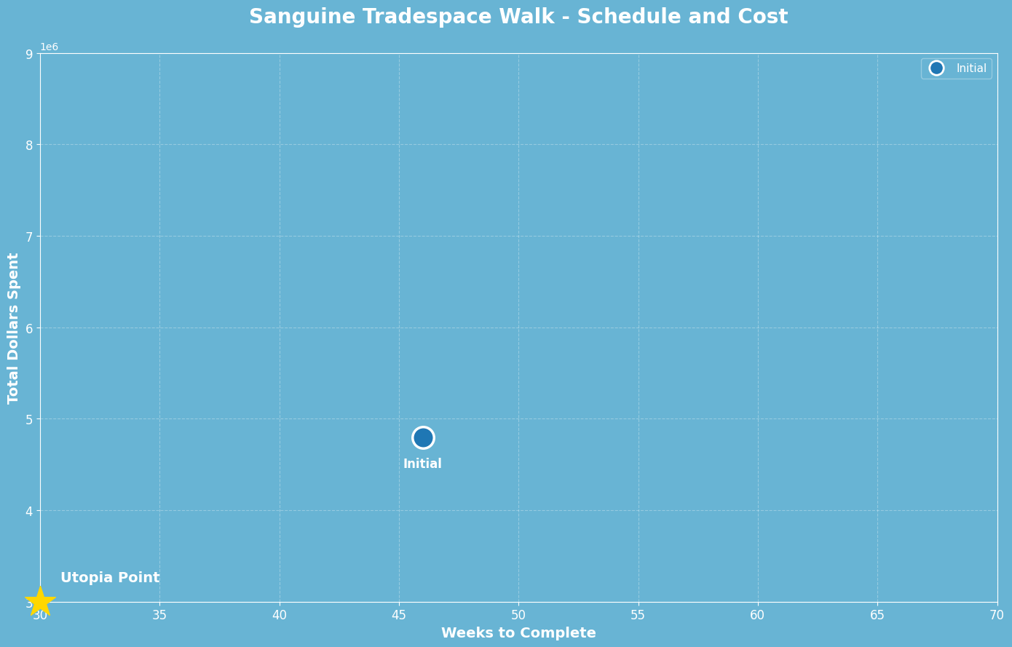
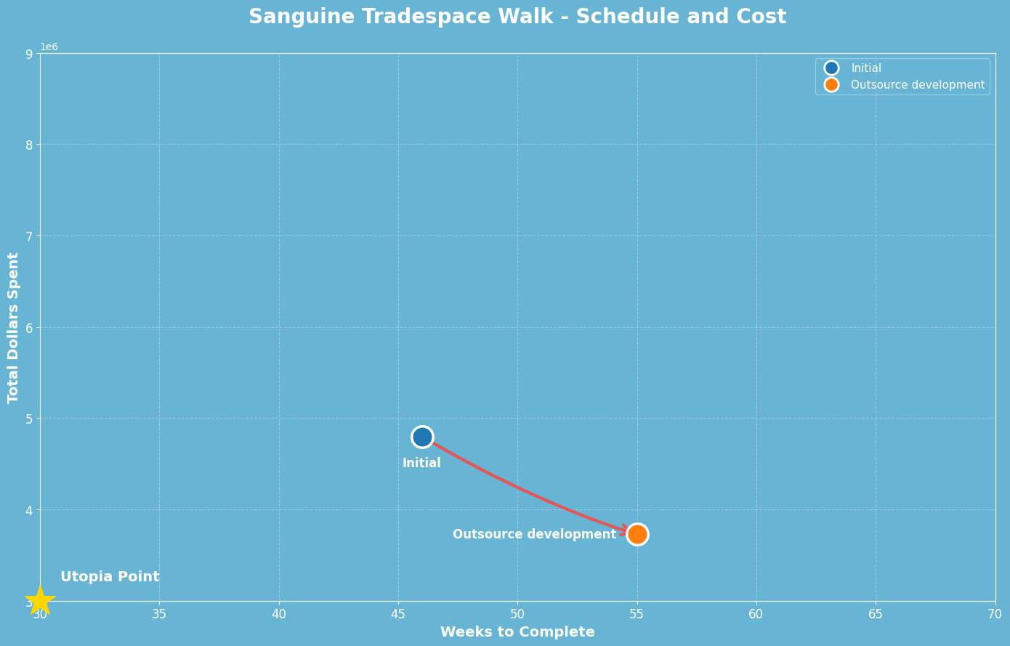
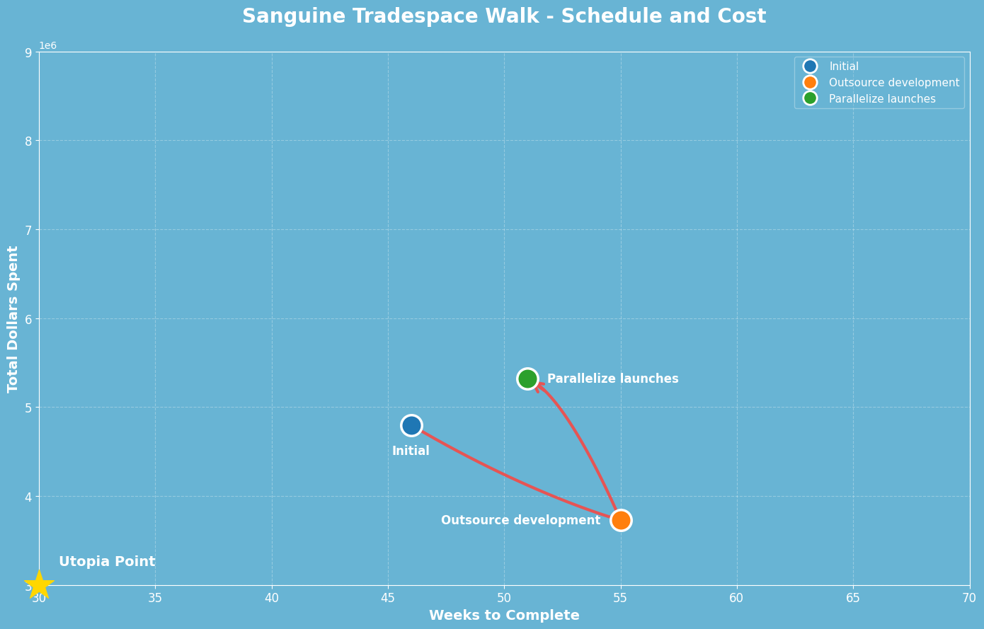
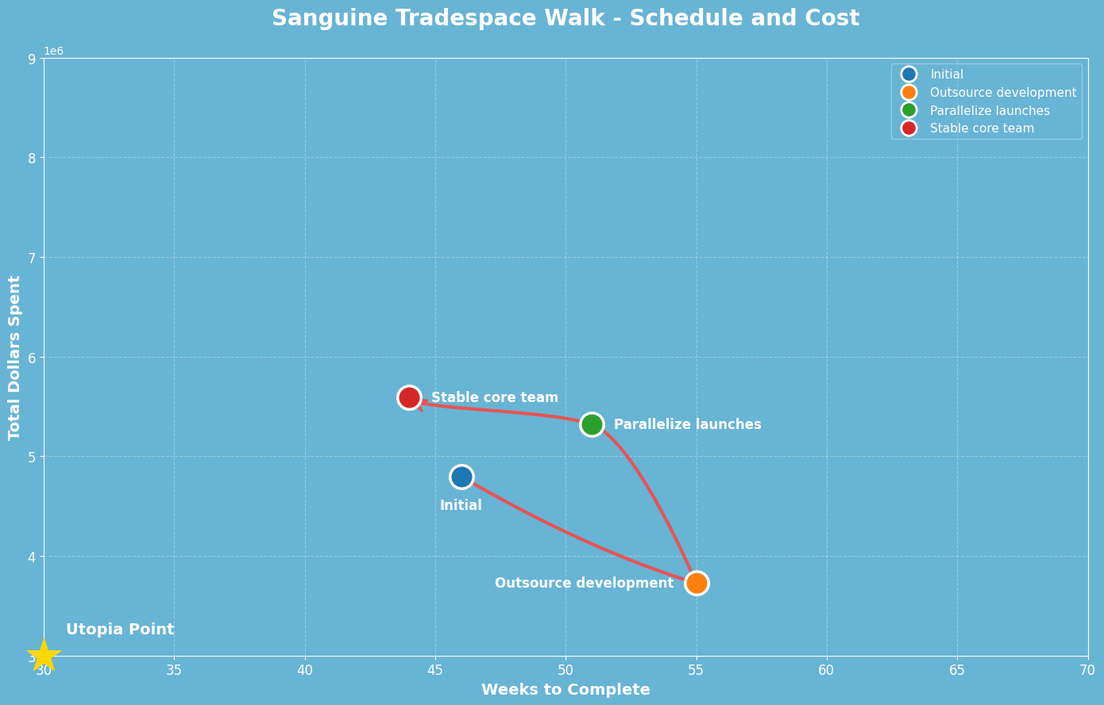
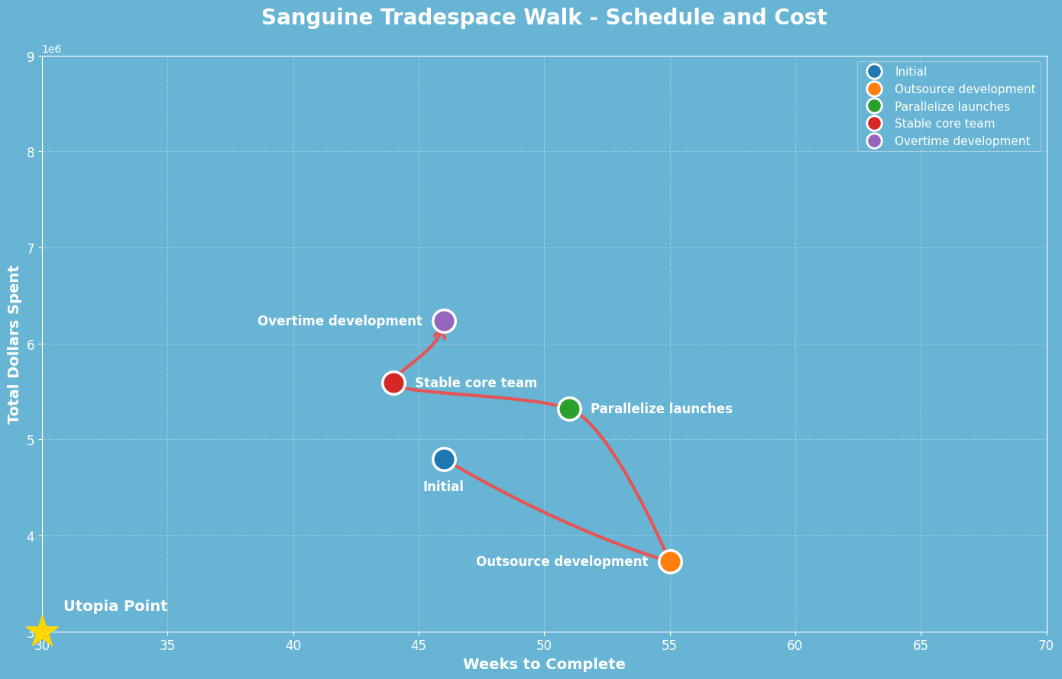
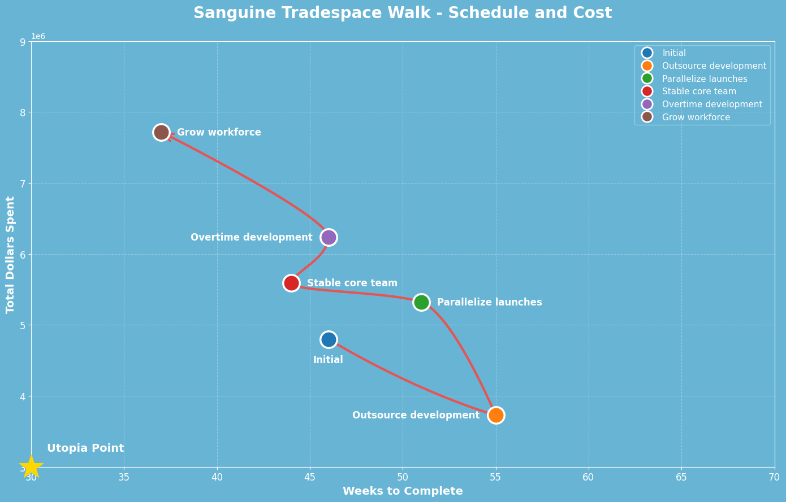
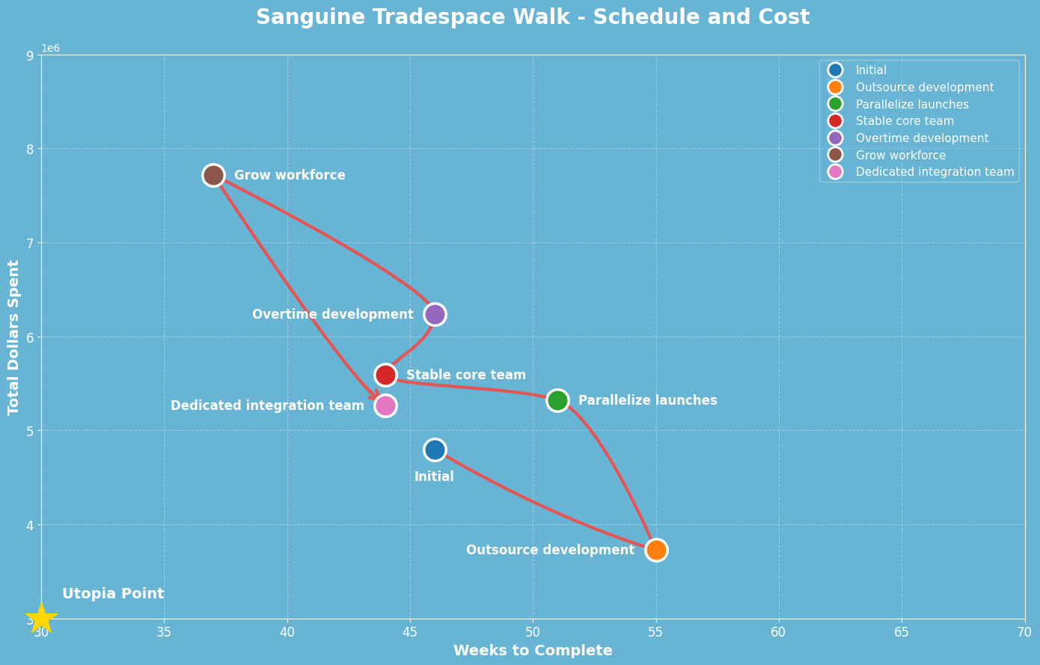
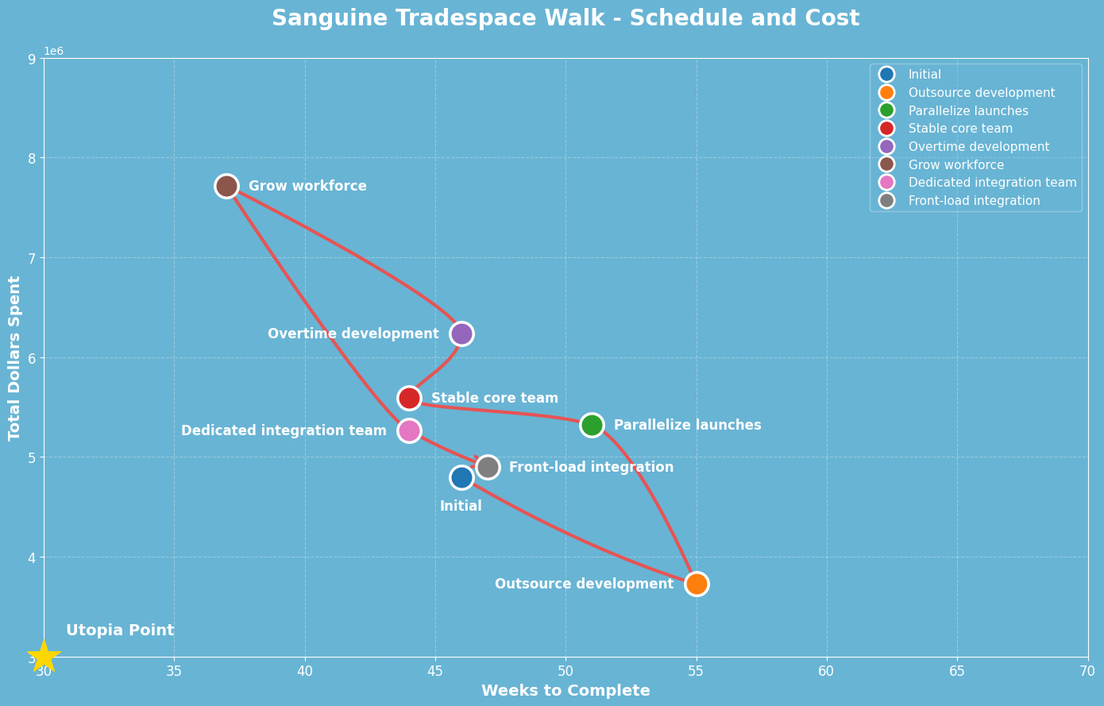
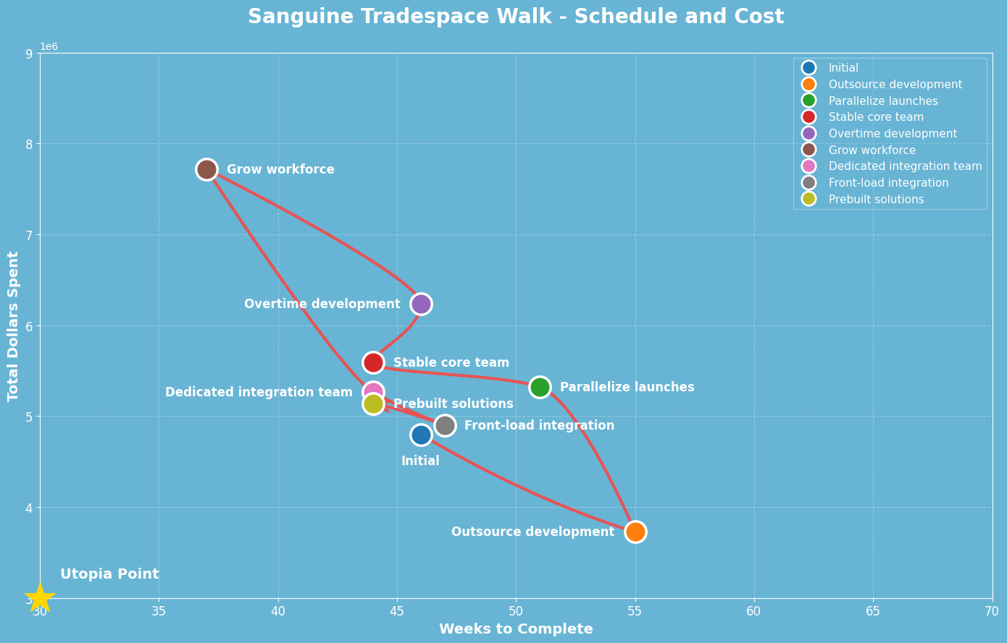
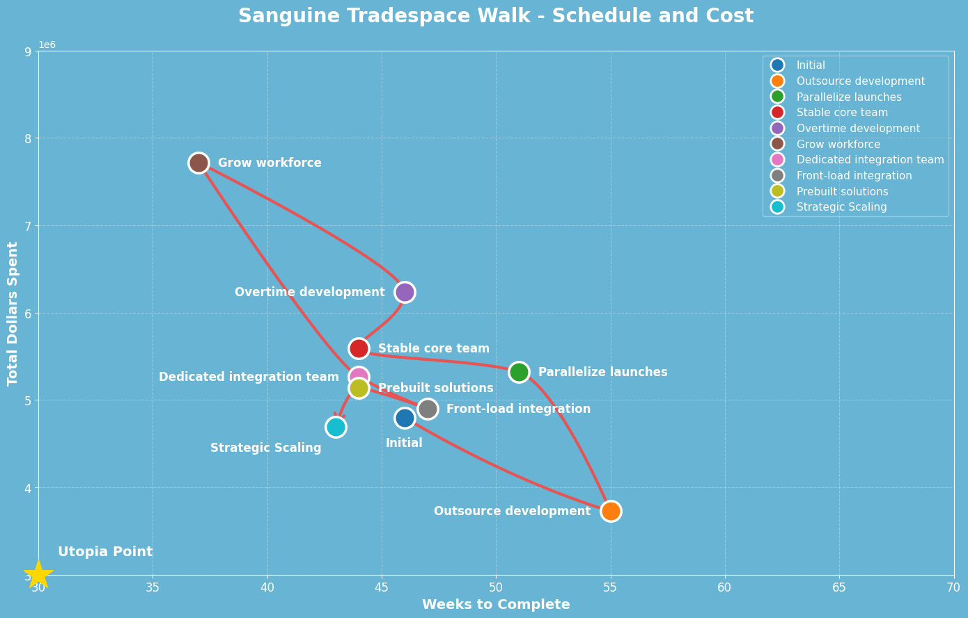
First schedule and cost tradespace
Notes:
we began by modeling a tradespace, evaluating methods to optimize cost and schedule. We reviewed outsourcing, parallel paths, shifts in teams, leveraging overtime, expansion, shifting team and work, and finally end with the concept strategic scaling.
This is along the pareto frontier and reduces both cost and schedule

Slide 22
Cost and Schedule Decision
Cost and schedule preferred plan
After a first review, of our tradespace walk settled on Strategic Scaling as the preferred plan.
$4.69M / 43 weeks. It satisfies the $6M budget target with 22% headroom,
Achieves the Q2 2027 prototype milestone comfortably, and avoids the coordination risks of full outsourcing.
Notes:
We landed on strategic scaling as our first preferential plan.
This employs contractors in strategic ways, within the non-key areas of implementation, to reduce cost and accelerate development
We are left with ample headroom relative to our targets.

Slide 23



Metrics
Metrics for Context
Volume
Assets
Opportunity
40,000 patient samples per day
More than 70 countries around the globe
Mayo Clinic Platform_Insights
26 petabytes of clinical information
3 billion laboratory tests
1.6 billion clinical notes
10 million peer-reviewed biomedical publications annually
U.S. clinical laboratory tests market size: $52.77 billion in 2024
6.1% CAGR from 2025-2034
Sources: Mayo Clinic [1][2], Polaris Market Research [3], [2] Mayo Clinic, [4 ]Mayo Clinic Research.
Notes:
Zooming out for a moment:
Mayo Clinic handles 40,000 samples from external patients across the globe.
Their Platform_Insights datalake is roughly 26PB, with billions in tests and clinical notes
In the US a market size in clinical laboratory tests of 50 billion, with growth over the next decade
Mayo Clinic has a unique opportunity to improve physician empowerment and defend their position within this growing global market But, to step back. RAND analysis found that 80% of AI projects fail to deliver their intended business value. This is echoed elsewhere.
The perils of AI pilot project failure are common, and we must ensure we properly manage this immense opportunity to better serve physicians and their patients.
This create a shift in understanding

Slide 24
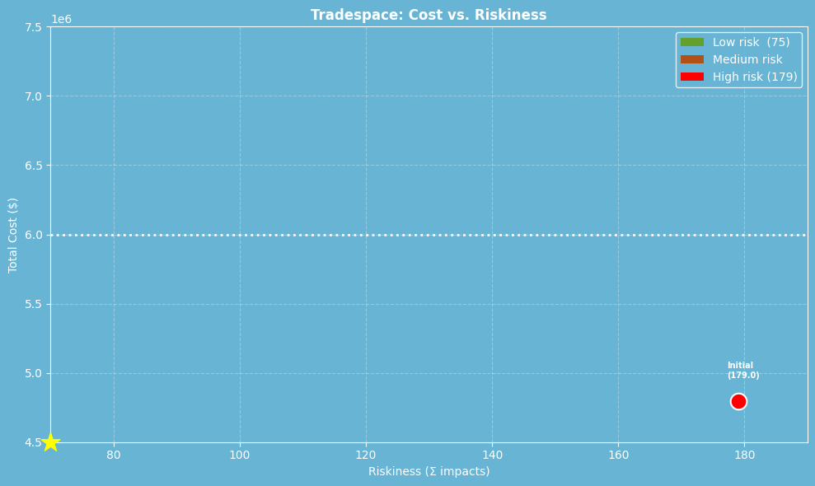
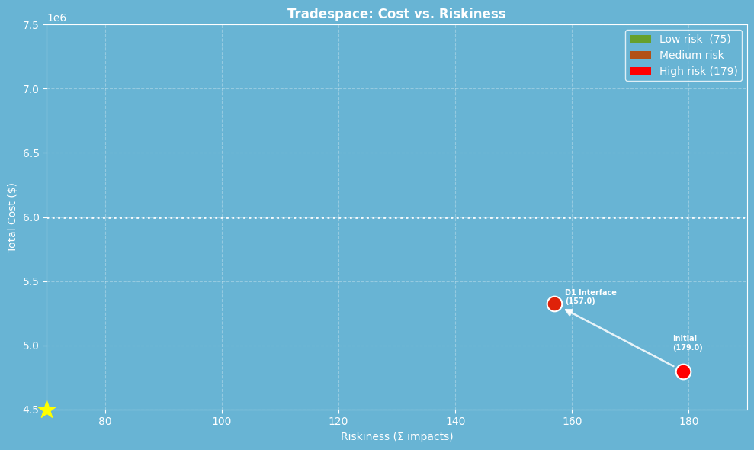
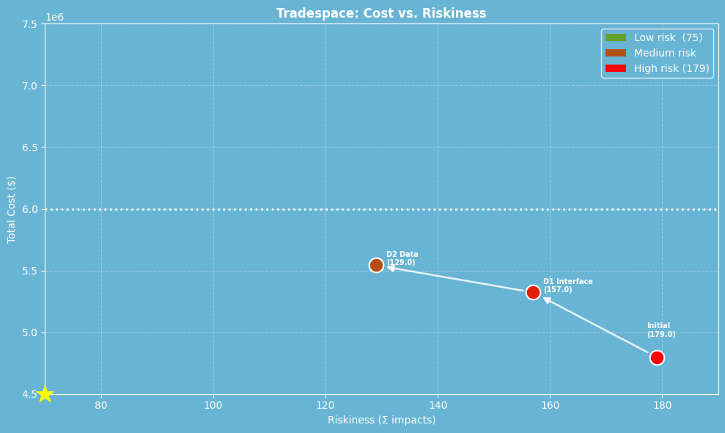
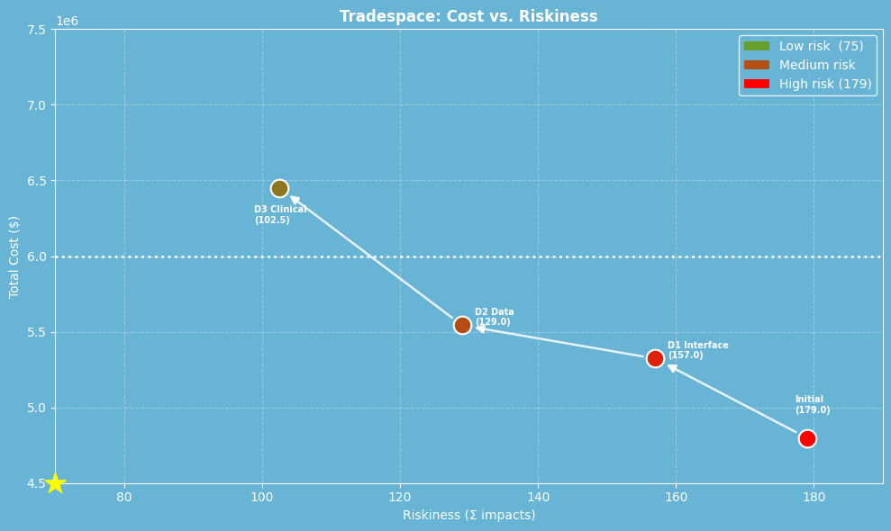
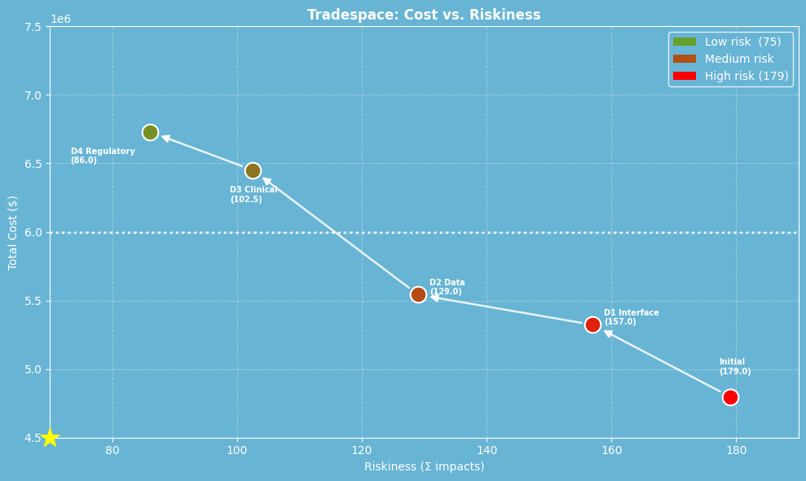
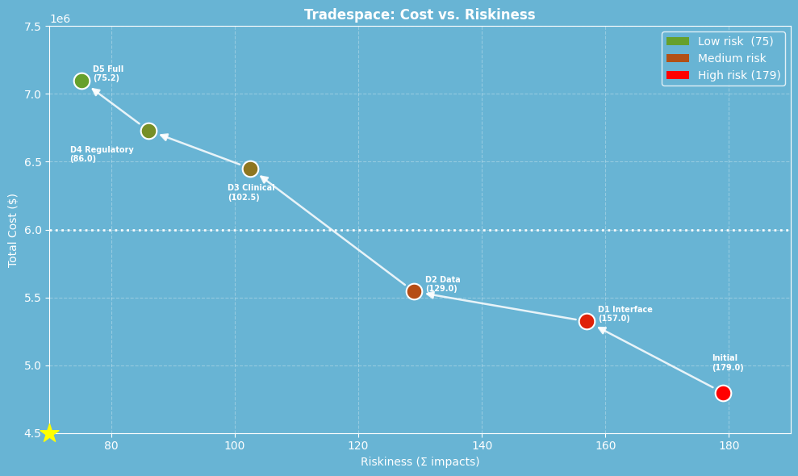
Risk Tradespace Walk
Notes:
So we re-evaluated our tradespace walk, this time comparing cost of the project versus risk exposure,
Focusing on reducing risk exposure of data integration, clinical and regulatory hardening, and leveraging early verification & validation of interfaces to significantly reduced risk profile.
At the end, our full profile more than halved our risk exposure, although at a cost.

Slide 25
Reducing Risk Exposure
Reducing Risk Exposure
Prioritizing reduction of risk exposure creates a new “Full” architecture with expanded costs and schedule:
$6.45M and schedule to 50 weeks, exceeding the $6M target but staying within the 50-week target.
The tradeoff targets integration failure, and late rework before clinical validation.
Notes:
But that cost must be compared to the potential cost of failure, and we feel this tradeoff is justified to reduce risk within integrations and the additional cost of rework before clinical validation.
In the end we recommend this lower risk profile of “Full” with an expanded cost of $6.46m, which is in excess of our $6m budget. But still remaining within our 50 week target

Slide 26
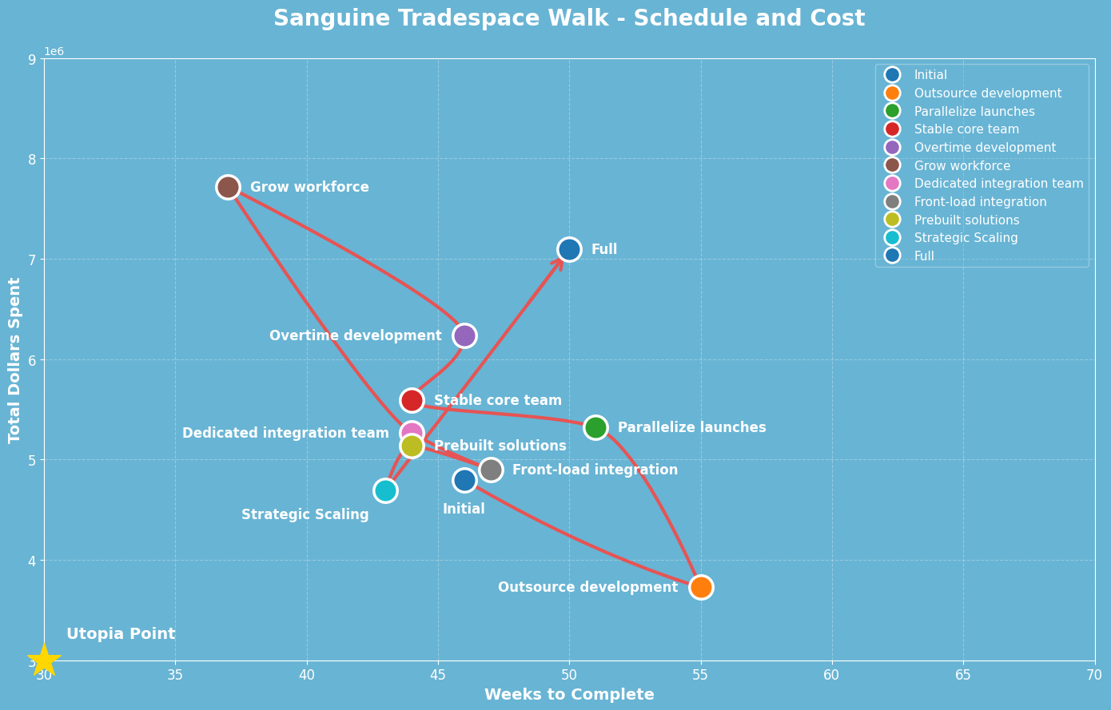
Cost/Schedule Tradespace
Notes:
If we return to this first tradespace walk that sets the utopia point at the lower cost and shortest schedule, you can see that this model no longer aligns with the values of our project.
Instead when we plot this new “Full” tradespace, we are far from the strategic scaling point that simply prioritised cost and schedule. But the unshown third dimension of risk exposure renders this tradespace only useful for context.

Slide 27






Product Concept: Full
Gemini model family
Multiple internal and external sources
Large specialized group
Multimodal, higher cost model
RAG and fine-tuning
Tiered release
The selected concept prioritizes clinical accuracy, traceability, and safe deployment over minimum cost. Its added complexity is intentional: stronger models, richer evidence sources, specialized AI roles, and tiered release controls create a more reliable physician-facing interpretation system.
Notes:
In the end, our final product concept leverages Mayo Clinic’s strategic partnership with google and uses the gemini models,
we leverage the platform_insights internal sources, internal research, along with validated external sources,
our models serve various roles with distinct specialities, similar to the internal mayo clinic model of care
And we use higher cost multimodal, with RAG and Fine tuning along with a tiered release to ensure reliability and quality.
Clinical excellence is synonymous with Mayo Clinic and our project seeks to follow suit.
Thank you

Slide 28

Q&A

Slide 29
Acknowledgements
Thank you to our sponsor Dr. Garcia, Mayo Clinic, MITsdm, MIT commlab, our TA project Angela Tomczik and advisor Eric Rebentisch, and all the MITsdm TAs and advisors who provided valued insights and feedback during this project.

Slide 30

Appendix

Slide 31
AI Architecture
How do we architecture AI to fulfill this role?
Identity
Private Health Information
Trust Boundary
Result
Patient Context
Prior History
Abnormal Patterns
Case Framing
Mayo Clinical Knowledge
Research Evidence
Guidelines
Evidence Base
Specialist Roles
Synthesis
Prior Reconciliation
Interpretation Core
Traceability
Safety Gates
Approval Rules
Escalation
Clinical Review
Workflow Delivery
Feedback
Physician Delivery
Notes:
This slide focuses on the USING of the SPS
TL,DR: Split into multiple slides
Reduce detail

Slide 32
Decisions
Decisions
ID | Decision name | Scope | Change since OS11 | Rationale | Option 1 | Option 2 | Option 3 | Option 4
D1 | Compute runtime | Form | Decided | We chose Single-Cloud to align with Mayo Clinic’s multi-year strategic partnership with Google Cloud_{[1]}. | Edge | On - prem data center | Single - cloud (Google Cloud) | Multi - cloud
D2 | Model Origin | Form | Changed options | On GCP, Gemini models are discounted_{[2]}. Specialized alternatives may be slightly more performant, but more expensive. We added D11 to choose the model type. | Gemini family only | Other closed source | Train our own | Open source
D3 | Research paradigm | Mapping | Changed options | This was the second-most architectural decision in OS11. We added a new option RAG + Fine-Tuning (Piazza @60). | RAG | Fine - tuning | Rely on pre - training | RAG + Fine-Tuning
D4 | Communication channels | Mapping | Removed | We discovered in OS11 that D4 is actually neither sensitive nor connected. | EMR only | Web UI only | App only | Web + App
D5 | Number of AI roles per test result | Mapping | Changed options | This is architectural, but we reoriented the bucket names and renamed the non-agentic option to be “no AI”, but then removed it because it's outside our SPS. | 0 (no AI) | 1 (single agent) | Small group (2-5) | Large group (5 - 10)
D6 | Data sources | Function | Kept | OS11 showed this is architectural, but we're renaming the options per OS11 feedback to be more strategic. | Mayo internal only | Mayo + single external source | Multiple internal+ external sources | Open Internet only
D7 | Coordination structure | Form | Removed | We discovered in OS11 that D7 is actually neither sensitive nor connected. | Agents as Tools | Swarm | Agent Graph / Workflow | No coordination
D8 | Clinical system integration | Mapping | Removed | This is not sensitive, and is only strongly connected to one decision we're keeping (D6), meaning this is a design detail. | MCP tools | API tools | N/A | N/A
D9 | Clinical validation and release control | Function | Kept | This was the single most architectural decision in OS11. We searched for more options, but these are the main ones. | Rule-based condition | Human - in - the - loop | Tiered release | N/A
D10 | Private information handling | Function | Removed | It's best to maximize integration, within compliance constraints. That makes this a constraint, not a decision. | No private exposure | Scoped PHI | No patient - identifiable PHI | N/A
D11 | Model Specification | Form | Added | This is a subset of D2, but still architectural because it's sensitive to metrics (M1, M4, M6, and M8) and connected to other decisions (D3, D5, and D10) | Efficient, Text-Only (Flash) | Reasoning, Medium price (2.5 pro) | Multimodal, powerful (3 Pro) | Mix multiple models

Slide 33

Do no harm
Do no harm
Unrealized systemic risks from hallucination and implementation challenges highlighted a need for risk mitigation. The Mayo Clinics Model of Care and long established brand trust demands we take considerable care in decisions impacting patient care, even indirectly. The implications on long chained risk to healthcare outcomes led to the formation of a new system
Notes:
(

Slide 34
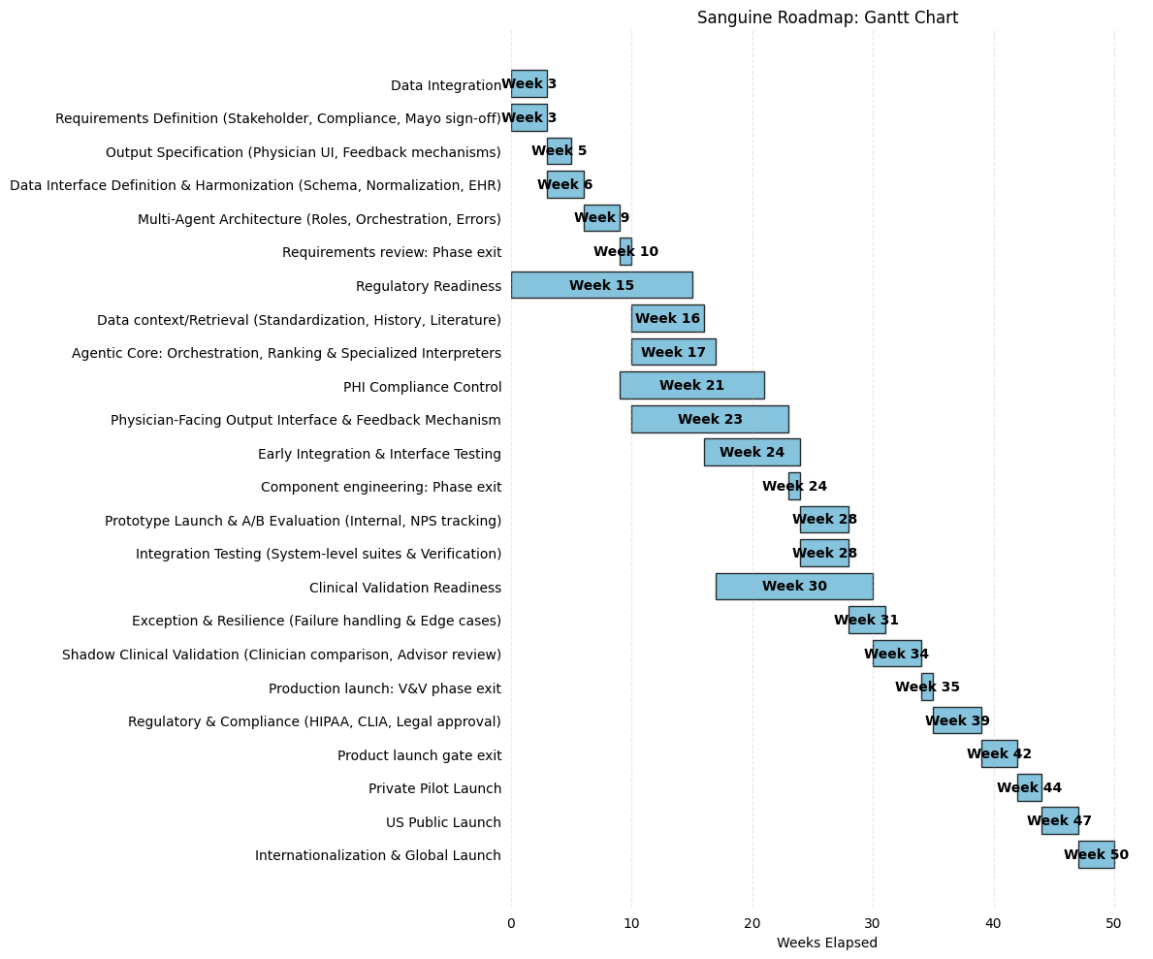
Gantt 1

Slide 35
Gantt 2

Slide 36
Mitigations
ID | Risk | Mitigation | Details | New Effect | New Prob. | New Impact | Commentary
M1 | R1 | Data Integration | 6 person-weeks; DATA + CLOUD; runs in parallel with T1.1 | 35 | 20% | 7 | Early technical proof-of-concept with Mayo Clinic IT. Reduces probability from 50% to 20% by discovering integration blockers before they cascade. Effect reduces because we have time to pivot architecture.
M2 | R2 | Clinical Validation Readiness | 8 person-weeks; AI + QA; starts after T2.2 | 50 | 15% | 7.5 | Structured clinical validation with a physician review board run before shadow mode. Reduces probability from 40% to 15%; residual effect remains high (50) because hallucination can never be fully eliminated from LLM-based systems.
M3 | R3 | Regulatory Readiness | 4 person-weeks; PM + QA; runs in parallel with T1.1 | 30 | 25% | 7.5 | Early IRB pre-submission and regulatory roadmap during the design phase. Reduces the probability from 40% to 25% and the effect from 60% to 30% by clarifying what evidence, documentation, and clinical study framing are needed before T3.2 (Shadow Mode & Clinical Review). This reduces the chance of discovering regulatory gaps only at the validation gate.
M4 | R4 | PHI Compliance Control | 4 person-weeks; CLOUD + DATA + QA; starts after T1.3 | 55 | 5% | 2.75 | Focused review of PHI handling, access control, logging, audit trail, data minimization, and compliance assumptions before real patient data is used in validation. Reduces probability from 15% to 5% by finding privacy and security design issues before T3.2 (Exception & Resilience Testing) and T3.3 (Shadow-Mode Clinical Validation). The effect is reduced from 90% to 55% because the early review allows the team to redesign and implement new controls before the issues affect the project as a whole.
M6 | R6 | Early Integration & Interface Testing | 6 person-weeks; SWE + DATA + AI + QA; starts after T2.1 | 40 | 20% | 8 | Early interface review and integration testing across the data pipeline, retrieval layer, agentic AI core, physician-facing workflow, and validation workflow. Reduces the probability from 40% to 20% by exposing interface assumptions before they become late problems. The effect is reduced from 75% to 40% because the difficulties and special integration needs identified during initial testing are easier to address than the cascading rework observed in phase T3.3 (Shadow-Mode Clinical Validation).

Slide 37
Mitigation Design
Design Name | Mitigations | Cost | Schedule (weeks) | Riskiness | Commentary
D0 No Mitigations (Baseline) | None | $4,798,352 | 46 | 179 | Unmitigated baseline. All risks at full exposure.
D1 Interface Alignment | M6 | $5,322,664 | 47 | 157 | Adds interface review and early integration testing. This first mitigation reduces late interface misalignment and cascading rework risk before integration problems propagate across the data pipeline, retrieval layer, agentic AI core, and validation workflow.
D2 Data Integration | M6, M1 | $5,542,664 | 47 | 129 | Adds data integration feasibility spike. This design reduces both late interface misalignment and EHR/Lab data integration risk, creating a stronger technical feasibility baseline before clinical validation is introduced.
D3 Clinical Validation | M6, M1, M2 | $6,451,288 | 49 | 102 | Adds clinical validation protocol and physician expert panel. This design reduces technical feasibility and clinical accuracy risk, but it crosses the $6M budget threshold because clinical validation adds significant review effort.
D4 Regulatory Roadmap | M6, M1, M2, M3 | $6,731,288 | 49 | 86 | Adds IRB pre-submission and a regulatory roadmap. This reduces regulatory approval delay risk after the technical and clinical validation path has already been partially de-risked.
D5 Full Mitigation | M6, M1, M2, M3, M4 | $7,095,600 | 50 | 75 | Completes the incremental mitigation path by adding PHI handling and compliance design review. This option produces the lowest residual risk, effectively mitigating hallucination and regulatory blockers, but it also has the highest cost and reaches the 50-week schedule limit.

Slide 38

Abridged Glossary of Terms
MCMC | Mayo Clinic Model of Care | “The Mayo Clinic Model of Care is defined by high quality, compassionate medical care delivered in a multispecialty, integrated academic institution. The primary focus, meeting the needs of the patient, is accomplished by embracing the following core elements (attributes) as the practice continues to evolve”. [4]
NPS | Net Promoter Score | (-100 - 100) Willingness to recommend this system. We want users to enjoy our system.
PAM | Patient Activation Measurement | (0-100) Quantifies how well prepared a patient is to manage their health. High PAM scores are correlated with better health outcomes, so an increase in PAM would imply improved patient outcomes.
HIPAA | Health Insurance Portability and Accountability Act of 1996 | “The Health Insurance Portability and Accountability Act (HIPAA) of 1996 establishes federal standards protecting sensitive health information from disclosure without patient's consent. The US Department of Health and Human Services issued the HIPAA Privacy Rule to implement HIPAA requirements. The HIPAA Security Rule protects specific information cover the Privacy Rule.”[5]
CAP | Collage of American Pathologists | “The CAP accredits laboratories that perform testing on specimens from human beings or animals, using methodologies and clinical applications within the expertise of the program.”[6]
CLIA | Clinical Laboratory Improvement Amendments of 1988 | “Regulations include federal standards applicable to all U.S. facilities or sites that test human specimens for health assessment or to diagnose, prevent, or treat disease.”
Notes:
RAG = Retrieval-Augmented Generation

Slide 39
Citations
[1] https://news.mayocliniclabs.com/2025/02/19/the-specimens-journey-to-the-laboratory-refined-processes-superior-quality-unwavering-care/
[2] https://newsnetwork.mayoclinic.org/discussion/mayo-clinic-launches-mayo-clinic-platform_insights-to-advance-digital-innovation-and-quality-improvement-across-healthcare/
[3] https://www.polarismarketresearch.com/industry-analysis/us-clinical-laboratory-tests-market
[4] https://history.mayoclinic.org/toolkit/mayo-clinic-model-of-care/
[5] https://www.cdc.gov/phlp/php/resources/health-insurance-portability-and-accountability-act-of-1996-hipaa.html
[6] https://www.cap.org/laboratory-improvement/accreditation/laboratory-accreditation-program
[7] ttps://www.cdc.gov/clia/php/about/index.html
[8] https://www.folio3.ai/blog/ai-project-failure-rate-stats
[9] [https://fortune.com/2025/08/18/mit-report-95-percent-generative-ai-pilots-at-companies-failing-cfo/
[10] https://www.rand.org/pubs/research_reports/RRA2680-1.html

Slide 40



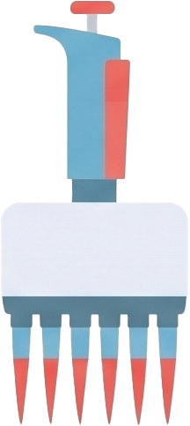
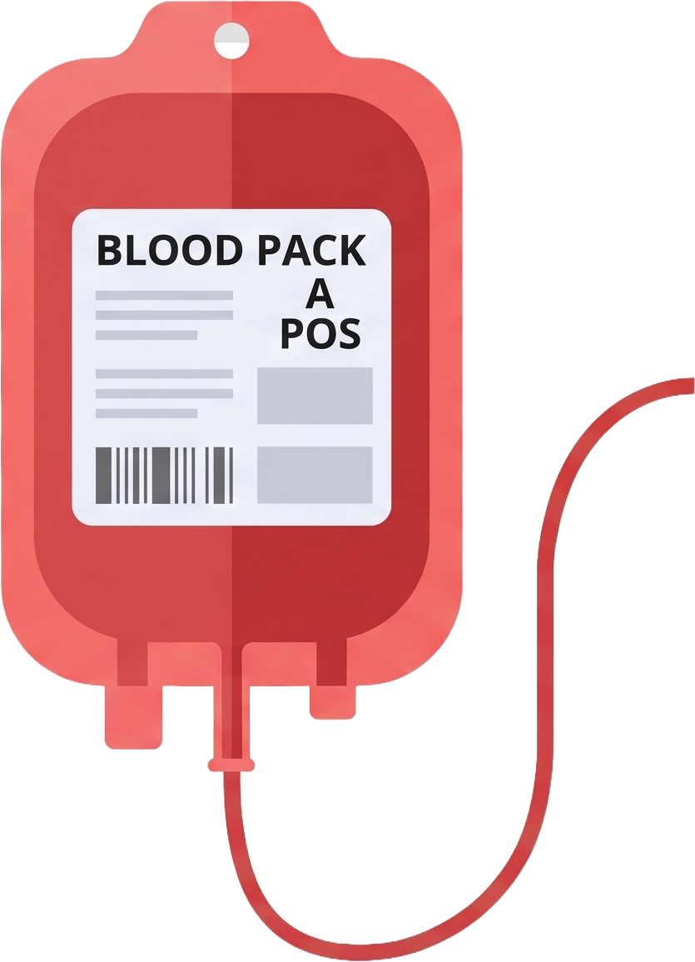


Font: Noto Sans Garantha
Assets:
Sanguine Blue: #68b4d4
Vial Dark Red:
#e65454
Vial Light Red:
#f16562

Slide 41





More Assets:
Sanguine Blue: #68b4d4

